Slide 1
MY MUSICAL WORLD WEB
Instructor: Tran Cong An
Nguyen Minh Nhut - B2205896 & Huynh Tan Dat - B2203438

Slide 2
About Web:
"My Musical World" is designed to create a vibrant music space, allowing users to easily explore and enjoy their favorite tunes. With an intuitive and user-friendly interface, the website simplifies the process of discovering and listening to music, providing a seamless and enjoyable experience.
The current version focuses on offering a diverse collection of music, enabling users to access new songs and connect with a community of music lovers. In the future, the website will continue to evolve with more interactive features, delivering a more comprehensive experience that enhances both music enjoyment and social engagement.

Slide 3
Current Feature
Login
Register with validate on mail
Forgot password
Logout
Give feedback
Show list of songs on index/vietnam/english/uploaded/
favorite page
Management user on admin page
Management songs on admin page
Update
Delete
User upload

Slide 4
Current Feature
Management favorites songs
Add
Delete
Management updated songs user page
Pagination songs on vietnam/english/uploaded page

Slide 5
Task Assignment:
Nguyen Minh Nhut:
Build the database.
Show list of songs with Ajax and Pagination
Design admin page
Management user
Update
Delete
User upload
Management uploaded songs of user
Management favorites songs with Ajax
Add
Delete
Fix bugs and adjust logic in existing code.

Slide 6
Task Assignment:
Huynh Tan Dat:
Supplement and verify database attributes, and build test datasets.
Login.
Register with validate on mail.
Forgot password
Logout.
Give feedback from user.
Design index page.
Design user page.
Profile page
Vietnamese songs
English songs
Adjust interface elements, including images, colors, and layout design.

Slide 7
Technologies Used in the Project:
HTML
CSS(Bootstrap)
JS(jQuery)
PHP
AJAX
Pagination
Session Management

Slide 8
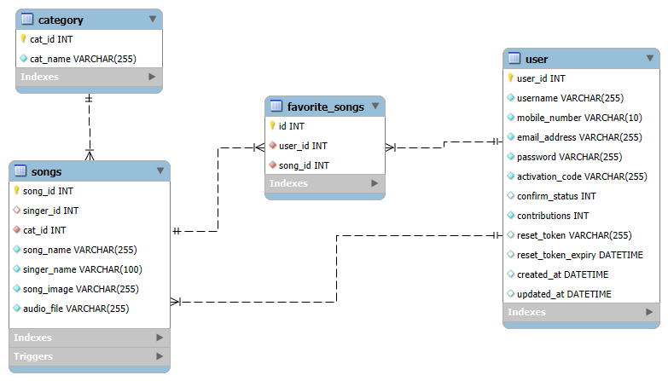
Database diagram:

Slide 9
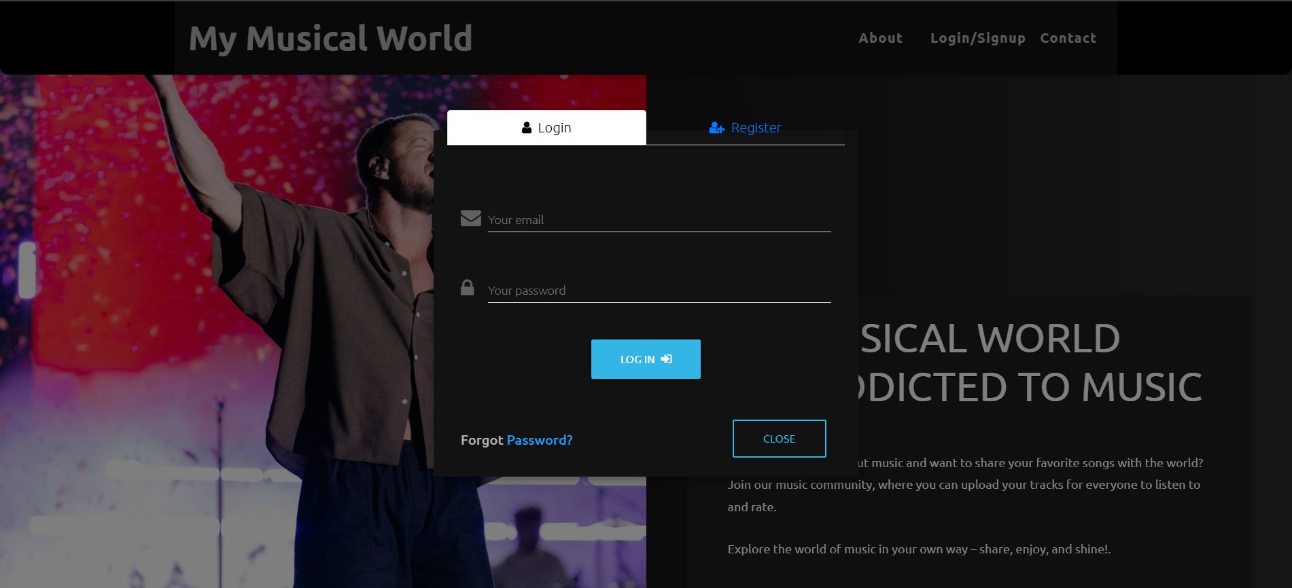
Login interface

Slide 10
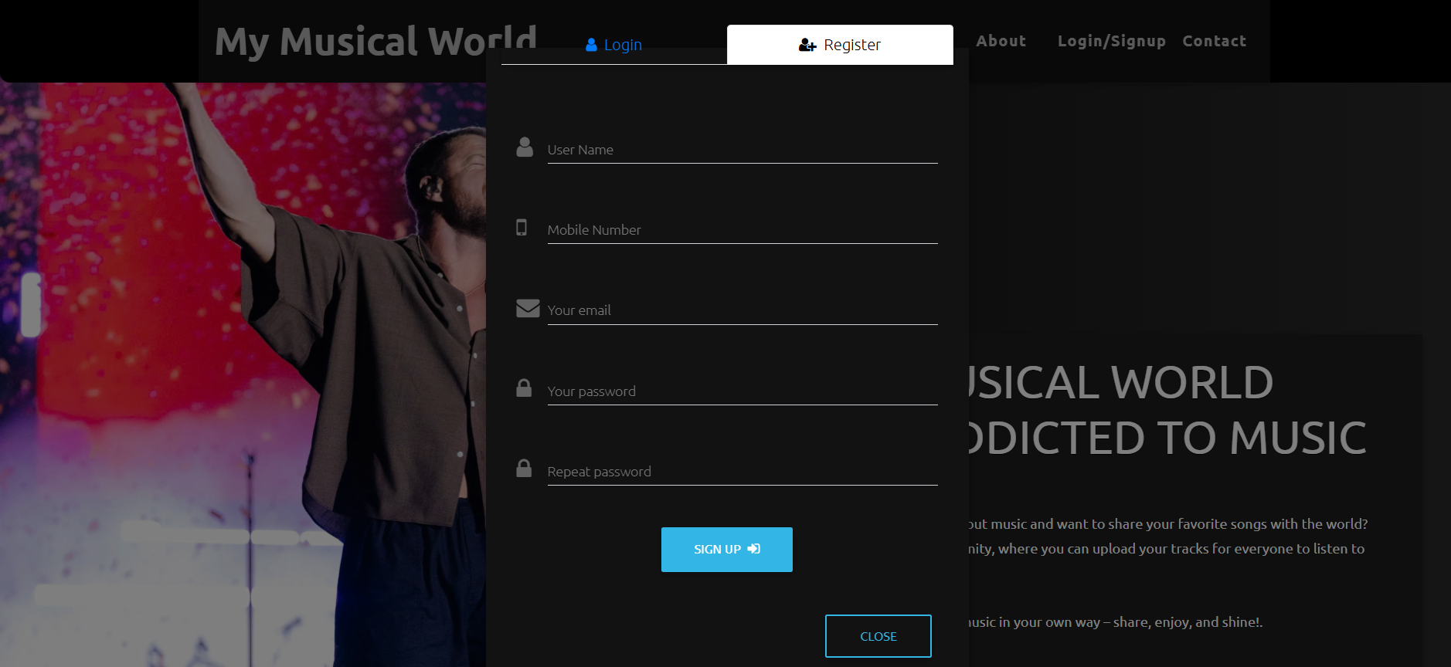
Register interface(mail verify)

Slide 11
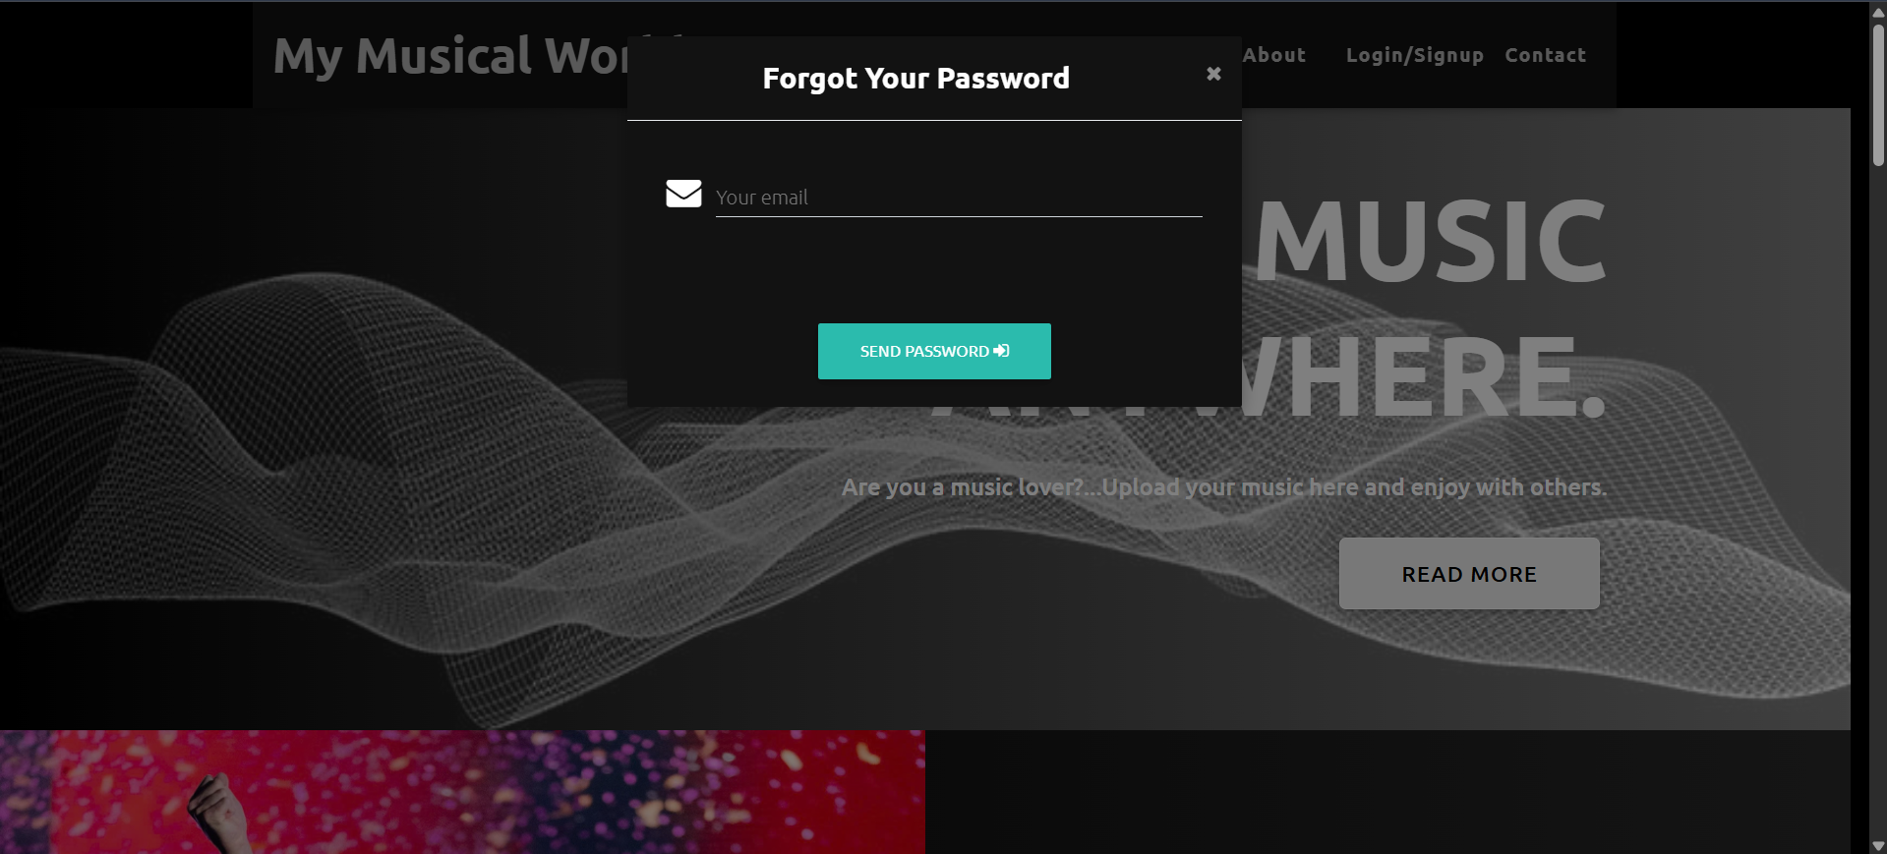
Forgot password interface

Slide 12
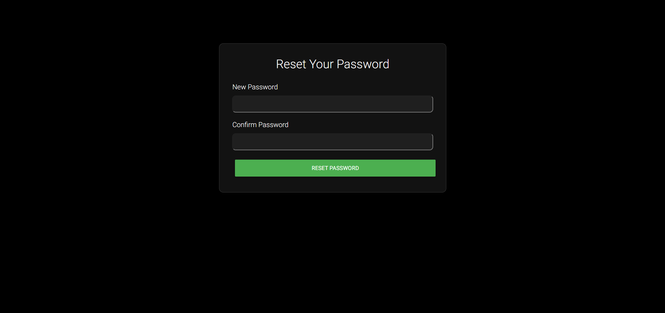
Forgot password interface

Slide 13
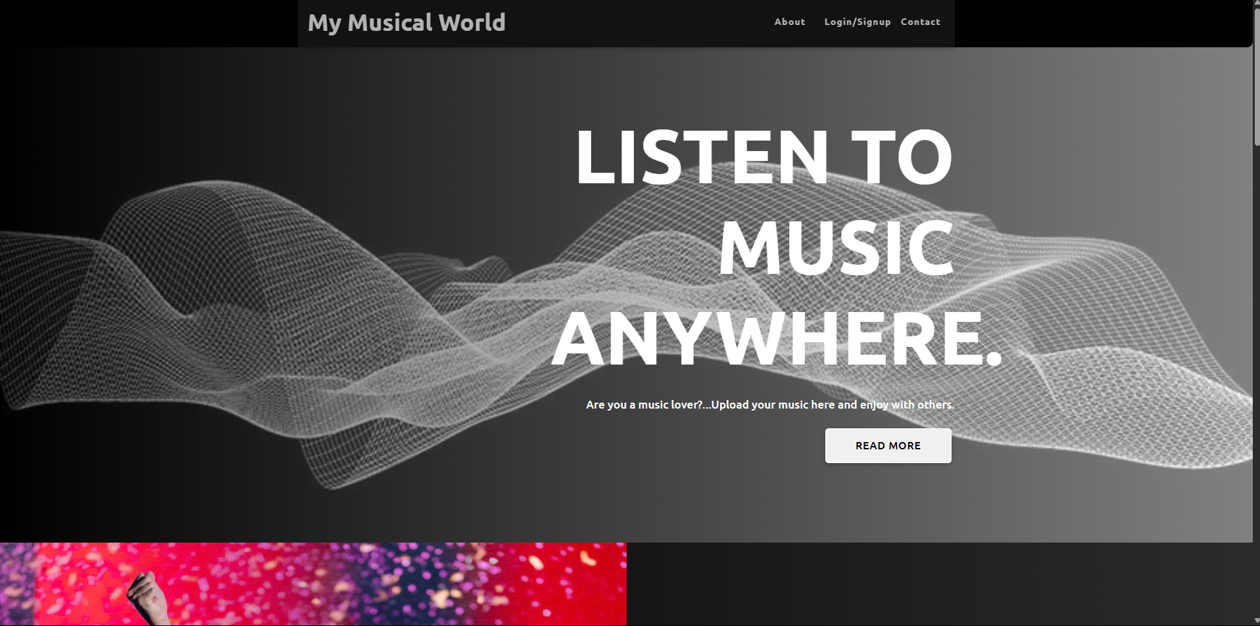
Index page

Slide 14
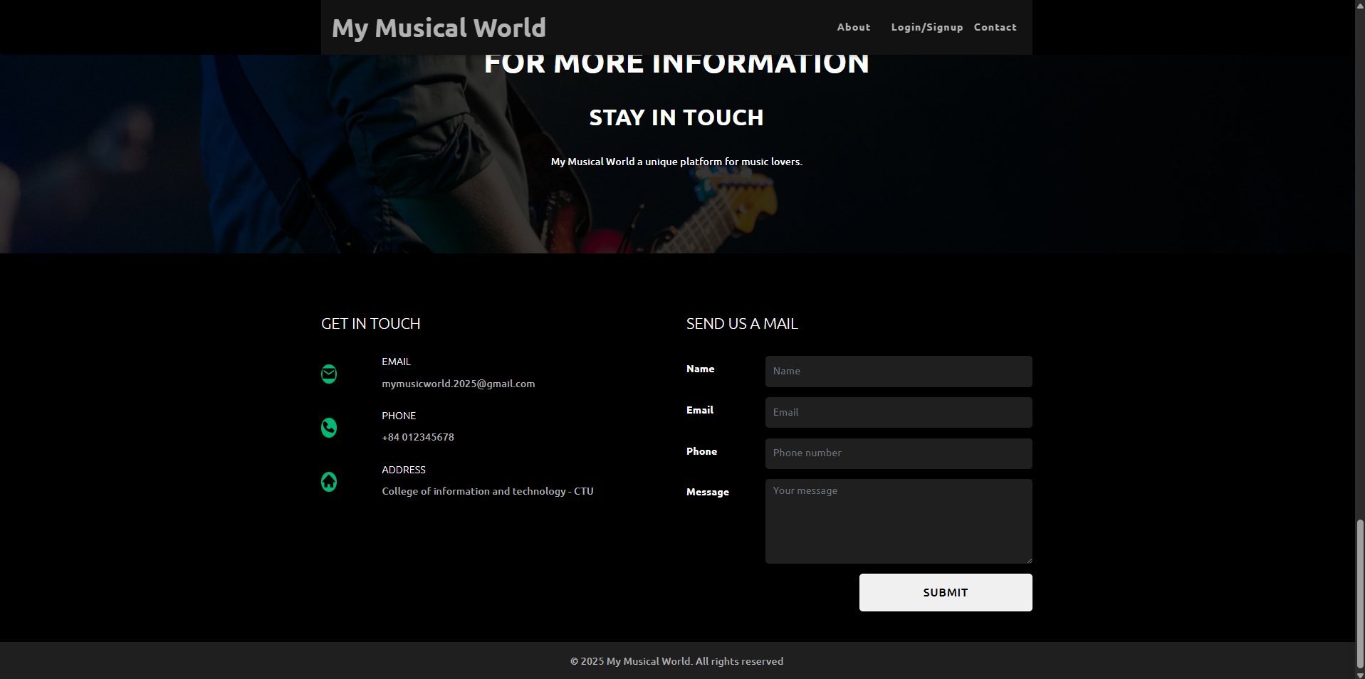
Give feedback

Slide 15
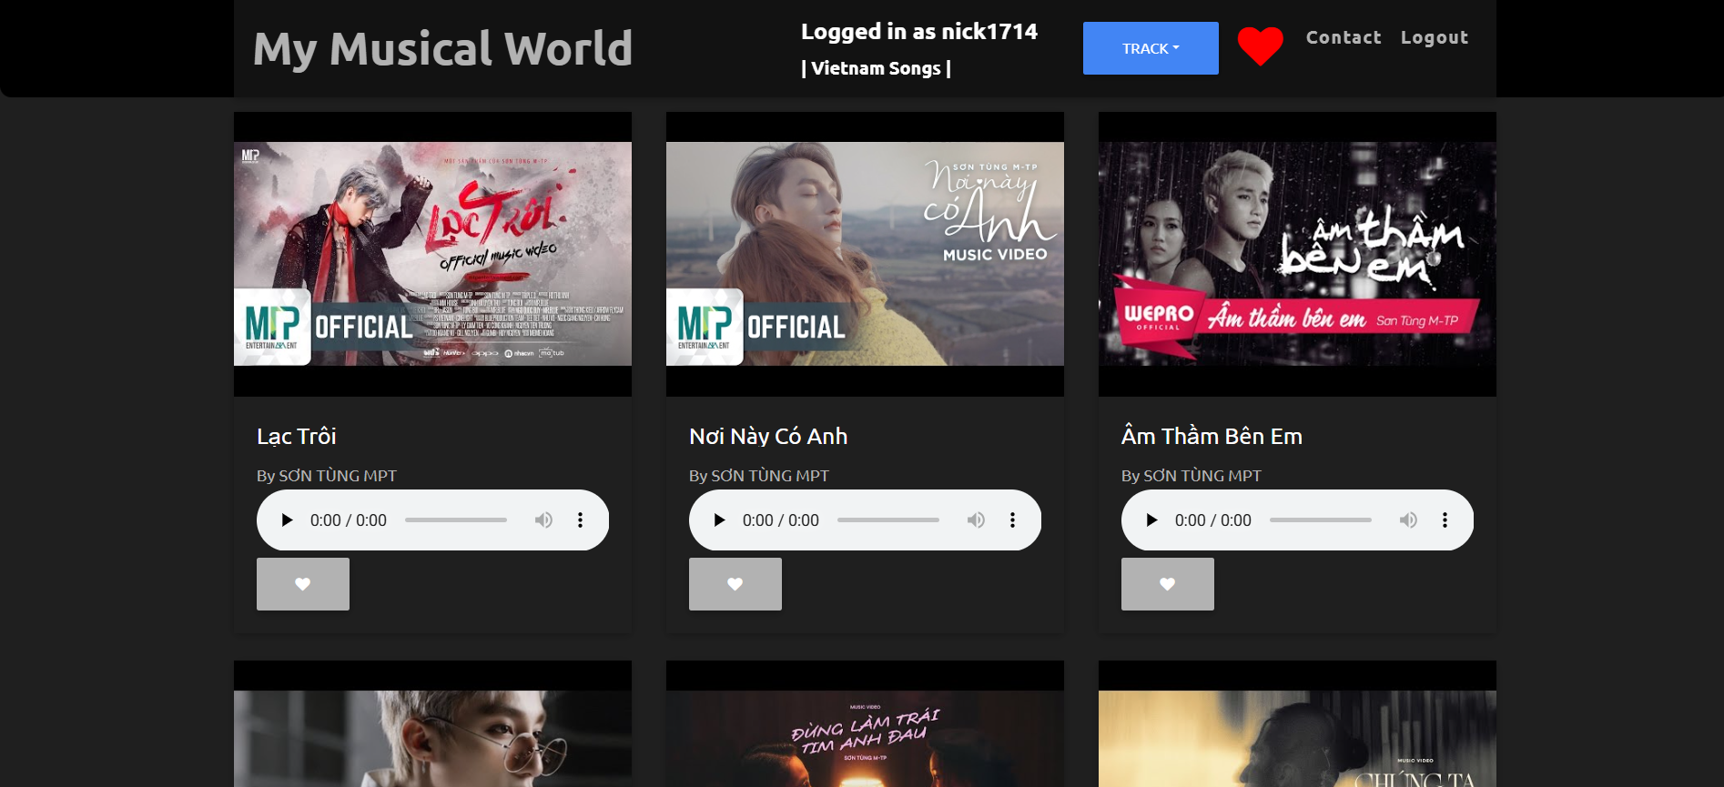
User page(Vietnamese page)

Slide 16
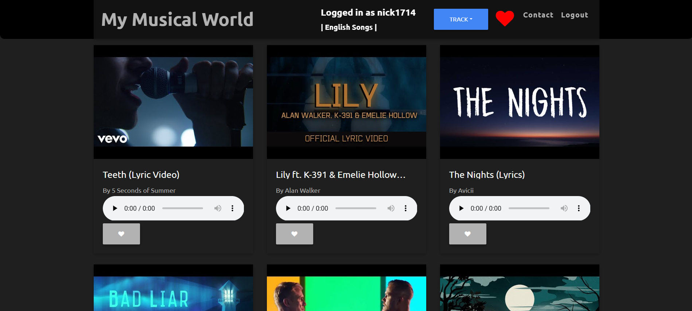
User page(English page)

Slide 17
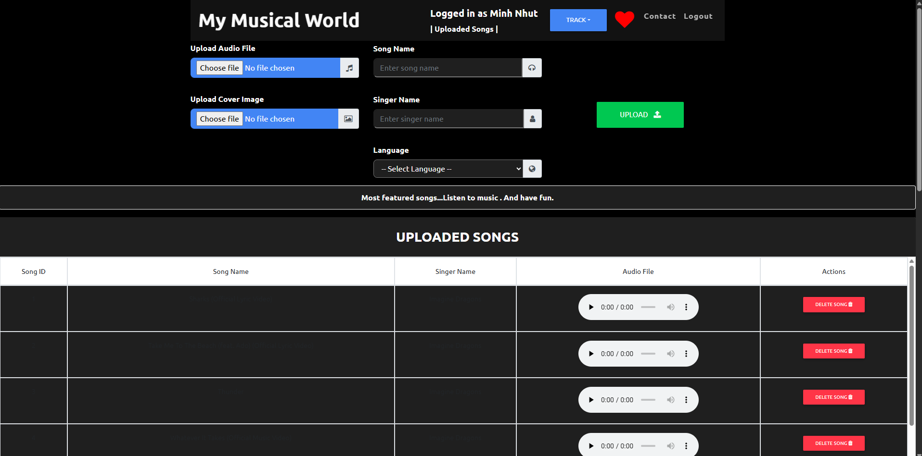
User page(Uploaded page)

Slide 18
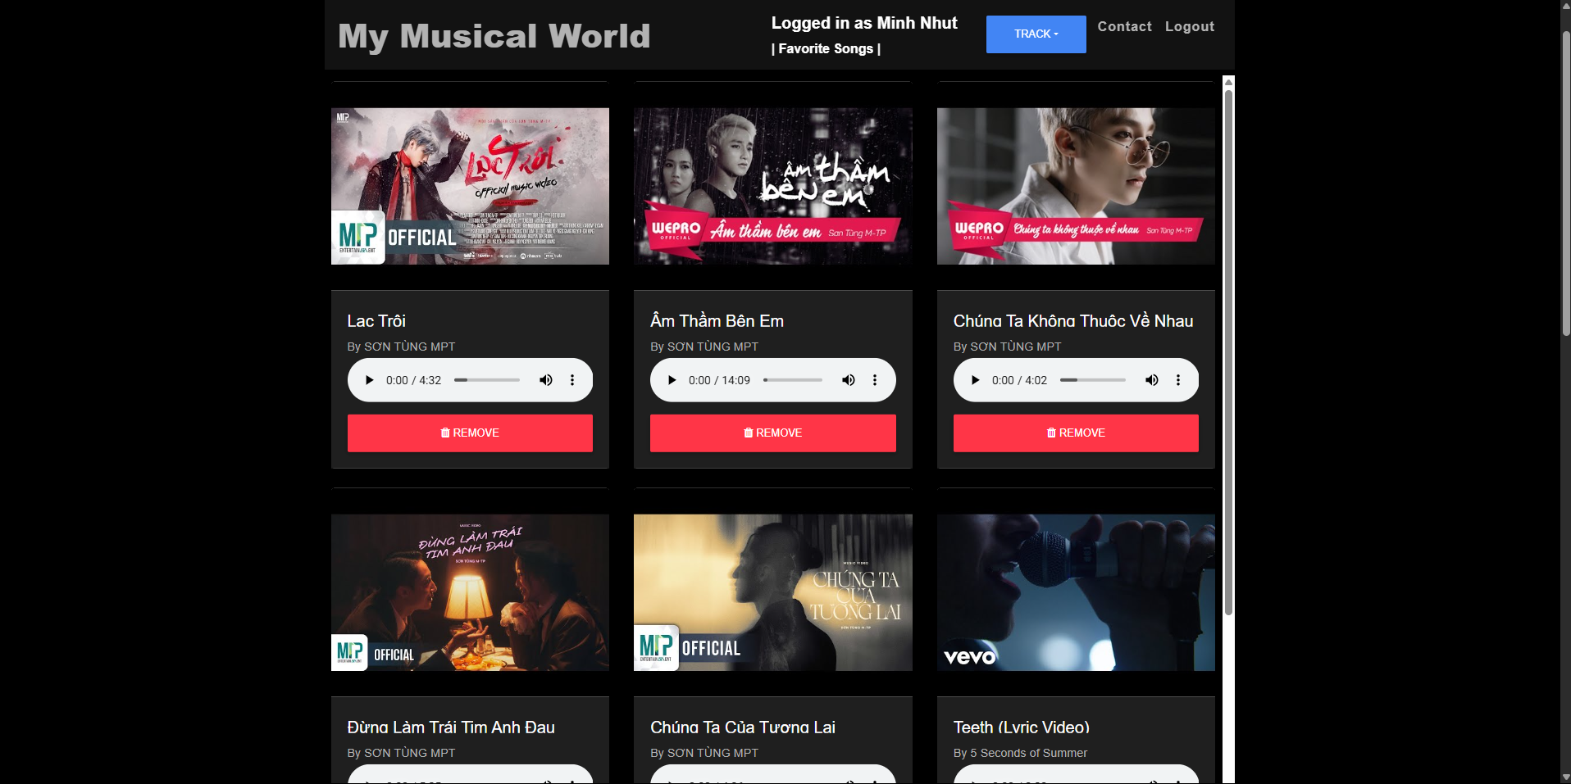
Favorite page

Slide 19
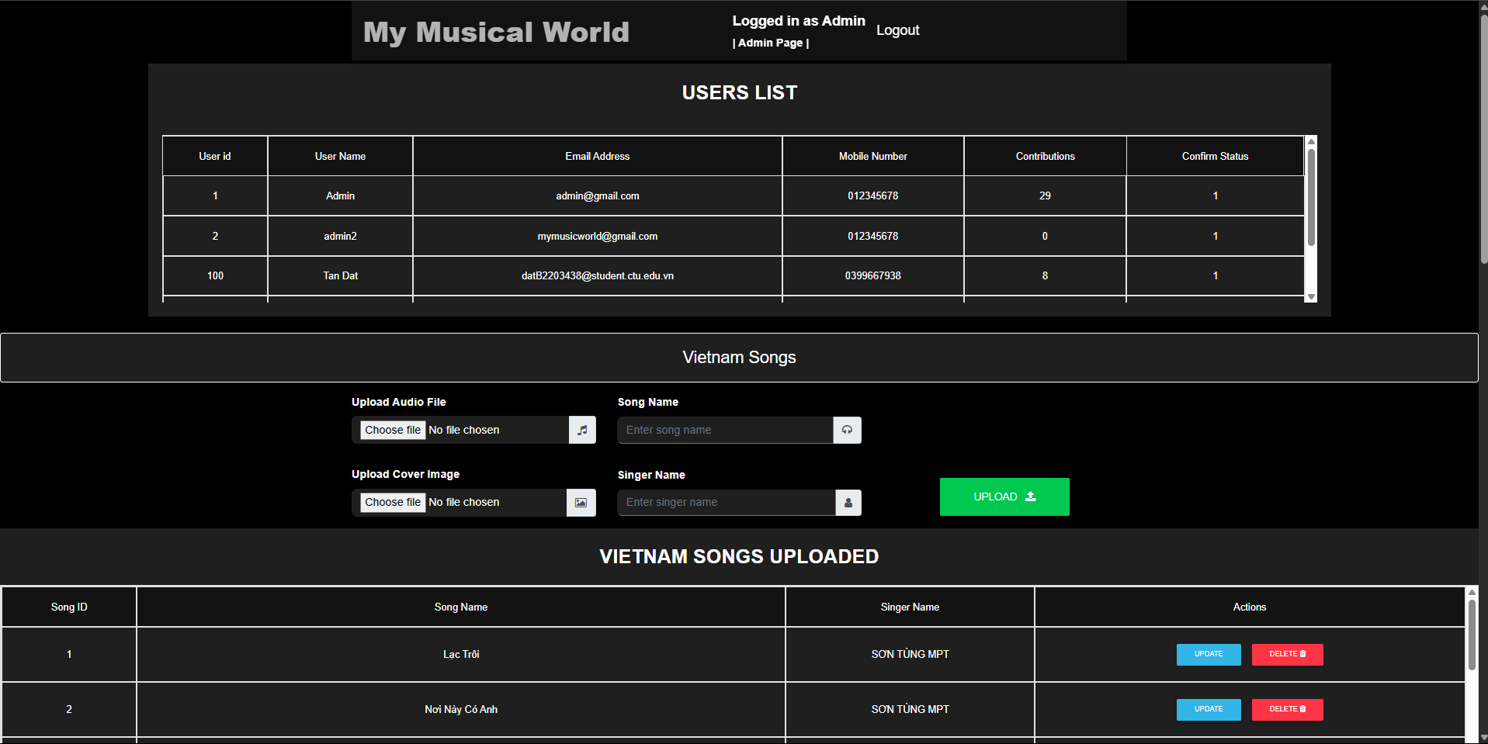
Admin page(Uploaded page 1)

Slide 20
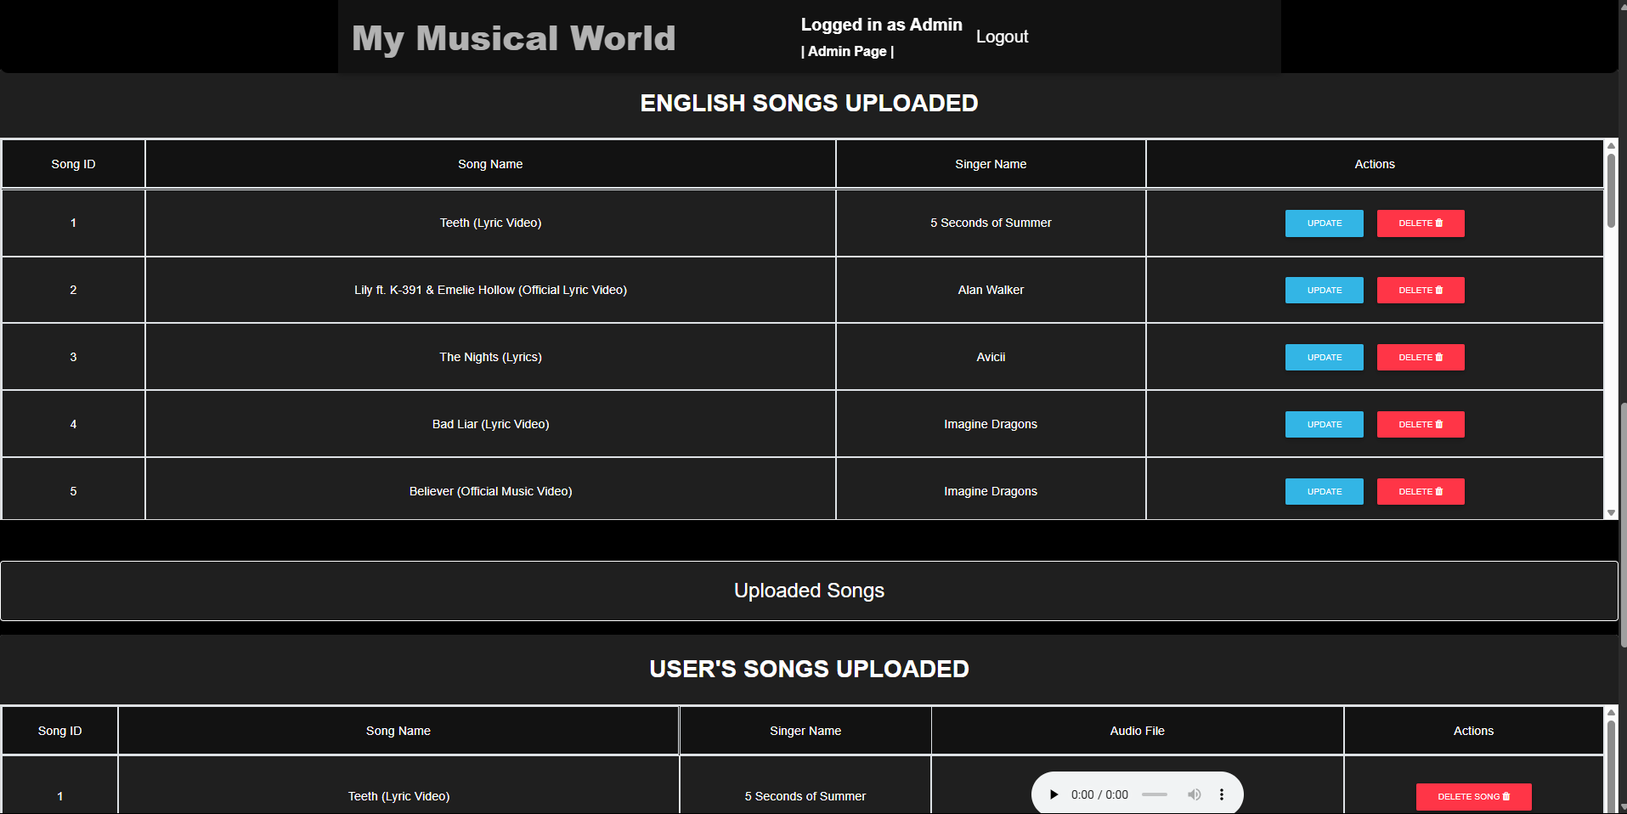
Admin page(Uploaded page 2)

Slide 21
References
https://www.w3schools.com
https://www.tutorialspoint.com/index.htm
https://www.w3schools.com/bootstrap/bootstrap_get_started.asp
https://getbootstrap.com
https://www.w3schools.com/jquery/default.asp

